Slide 1


PERSONALIZED HEALTH AND
Fitness AssistanT

Slide 2

INTRODUCTION
1
Introducing our groundbreaking Personalized Health and Fitness Assistant, powered by machine learning!
In today's world, where health and fitness are paramount, we're proud to unveil a project that combines cutting-edge technology with personalized care to revolutionize the way we approach wellness.
Our machine learning-powered assistant is not just another fitness tool – it's a dynamic system that analyzes vast amounts of data to tailor recommendations specifically to you. By understanding your unique goals, preferences, and even physiological responses, it crafts a bespoke plan to optimize your health and fitness journey.
But this project is more than just about customization. It's about harnessing the power of artificial intelligence to create an interactive and adaptive experience. Imagine a companion that learns and evolves alongside you, continuously refining its guidance to ensure maximum effectiveness.
As we delve into this exciting venture, we're committed to pushing the boundaries of what's possible in personalized wellness. Join us on this journey as we harness the potential of machine learning to empower individuals to lead healthier, happier lives.

Slide 3
2
DATASET
In our dataset comprising 1000 rows and 23 columns, the variable "health_goals" serves as the target variable of interest. This pivotal attribute encapsulates the health aspirations and objectives of individuals within our dataset.

Slide 4
3
EXPLORATORY DATA ANALYSIS
1. Shape: Reveals dataset dimensions, aiding in understanding its size and structure.
2. Head() and Tail():Offer snapshots of initial and final dataset rows, aiding in identifying data issues.
3. Describe():Generates statistical summaries for numerical variables, revealing distribution insights.
These techniques are fundamental for effective data exploration before embarking on advanced analyses or modeling. They provide key insights into the dataset's size, structure, and composition. `shape` quickly reveals dimensions, `head()` and `tail()` offer snapshots, `describe()` provides statistical summaries, and `info()` offers a concise overview including data types and null values. Accessing column labels via `columns` aids in manipulation, while printing null values highlights missing data, guiding preprocessing decisions. Together, they establish a solid foundation for understanding and preparing the dataset.
4. Info(): Offers a concise dataset overview, including data types and completeness.
5. Columns: Provides column labels for manipulation and analysis.
6. Printing Null Values: Identifies and prints missing data, ensuring data completeness and reliability.

Slide 5
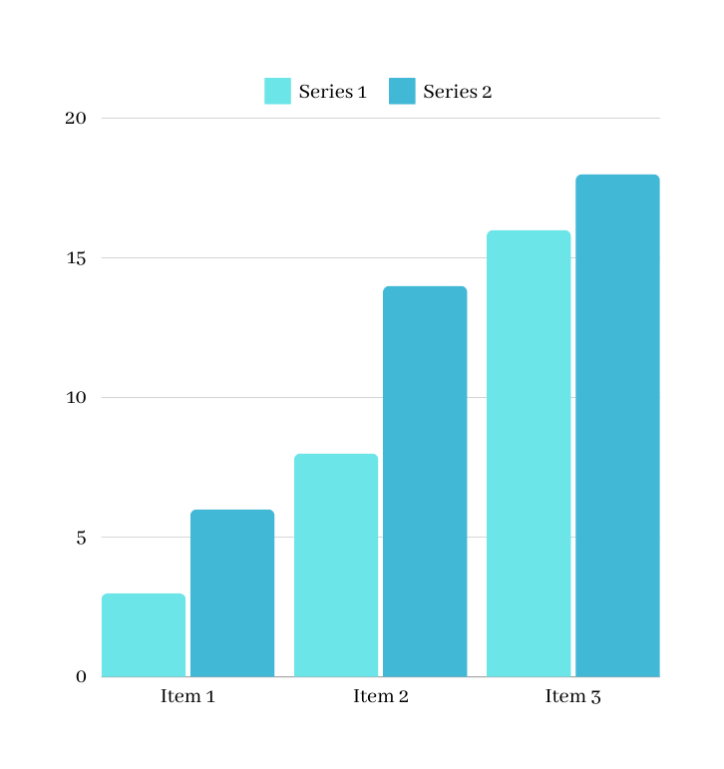
4
VISUALIZATION TECHNIQUES
1. Histograms (`histplot`): Seaborn's `histplot` visually displayed the distribution of numerical variables, aiding in identifying patterns and central tendencies, such as age, weight, and workout duration.
2. Correlation Heatmap: Seaborn's `correlation heatmap` provided a comprehensive overview of pairwise correlations between numerical variables, helping identify relationships like exercise duration's impact on calorie burn.
3. Countplot: Seaborn's `countplot` illustrated the frequency distribution of categorical variables, offering insights into user behaviors and preferences, such as exercise types and dietary choices.
4. Pairplot: Seaborn's `pairplot` showcased pairwise relationships between numerical variables, aiding in identifying correlations like those between body weight, workout duration, and calorie intake.
These visualizations provided invaluable insights into data distribution, feature relationships, and categorical variable frequencies, informing the development of personalized health and fitness recommendations.

Slide 6
5
MODEL METHODOLOGY
In our project, we began by collecting a dataset, ensuring it was clean by checking for and filling in missing values. We then divided the data into training (80%) and testing (20%) sets. Utilizing various visualization techniques such as box plots and pair plots, we gained insights into the dataset's characteristics. Moving on to machine learning, we applied several algorithms including Random Forest with Bagging, SVM with Kernel Trick, Logistic Regression with Recursive Feature Elimination (RFE), KNN with Isolation Forest, Decision Tree, and Gaussian Naive Bayes. After training the models, we found that the Random Forest with Bagging technique yielded the highest accuracy, demonstrating its effectiveness in our dataset.

Slide 7
6
Random Forest Classifier with Bagging is an ensemble learning method that combines multiple decision trees, effectively reducing overfitting and providing robust predictions. However, it may pose computational challenges for very large datasets.
Gaussian Naive Bayes, on the other hand, offers simplicity and efficiency, making it well-suited for classification tasks with continuous features. However, its assumption of feature independence may limit its effectiveness in datasets with correlated features.

Slide 8
7
Support Vector Machine (SVM) with Kernel Trick is a powerful algorithm capable of handling non-linear decision boundaries, making it suitable for complex classification tasks. Nonetheless, its performance may depend heavily on the choice of kernel and regularization parameters.
Decision Tree Classifier provides interpretability and insight into feature importance, making it valuable for exploring and understanding the data. However, it's susceptible to overfitting and may struggle with capturing complex relationships in the data.

Slide 9
8
KNN with Isolation Forest excels in anomaly detection and classification tasks, leveraging instance-based learning to identify outliers. Yet, its performance may suffer with high-dimensional or imbalanced datasets.
Logistic Regression with Recursive Feature Elimination offers simplicity and interpretability while effectively handling large datasets. However, it assumes a linear relationship between features and outcomes, potentially limiting its performance in non-linear scenarios.

Slide 10
9
﻿RESULT
Random Forest Classifier with Bagging -0.88
Gaussian Naive Bayes - 0.795
Support Vector Machine with Kernel Trick - 0.845
Decision Tree - 0.875
KNN with Isolation Forest - 0.81
Logistic Regression with Recursive Feature Elimination - 0.87

Slide 11
10
CONCLUSION
In summary, our exploration of classification techniques equips us with a versatile toolkit for developing machine learning models in our Personalized Health & Fitness Assistant project. Each technique offers unique strengths, including ensemble learning, probabilistic reasoning, non-linear boundary handling, interpretability, anomaly detection, and feature selection.
By carefully considering the nuances of each technique, we can tailor our approach to suit the specific characteristics of our data and project objectives. Moving forward, we will refine our models using insights from data visualization and preprocessing, aiming to enhance accuracy and usability. With a solid understanding of these techniques, we are well-prepared to deliver accurate and actionable recommendations, fulfilling the personalized health and fitness needs of our users.

Slide 12
THANK YOU

